Slide 1


DECODE ME!

Slide 2







2
1
3
4
5

Slide 3

These are taught to children.
These are the basic rhymes shown to children to be familiar to it.
We use these every time we write or speak.
ALPHABET
LPHATEAB

Slide 4
It is a vibration that travels through the air or another medium.
Can be heard when it reaches a person’s or animal’s ear.
NUSDO
SOUND

Slide 5
It is the way in which a word or a language is spoken.
It is the way a particular individual speaks a word or a language.
NUNPCIATONIRO
PRONUNCIATION

Slide 6
It is the rise and fall of the voice in speaking.
It is a matter of vibration in the pitch level of the voice or tone.
INIOTNTOAN
INTONATION

Slide 7
It is used by humans to share their knowledge, express their feelings by sending a message to their listener.
DSWOR
WORDS

Slide 8

OBJECTIVES
At the end of 60 minutes discussion, the students are expected to attain 90% of success on the following:
Identify the meaning of pronunciation.
Value the importance of knowing pronunciation.
Build the confidence to speak with proper pronunciation.

Slide 9
Pronunciation
Presented by: Jhenny C. Gregorio

Slide 10
Pronunciation is the act or result of producing the sounds of speech, including articulation, stress, and intonation, often with reference to some standard of correctness or acceptability.
Common Mispronunciation
Aisle
Tomato
(ile)
Congrats
(tuh-mei-tow)
Cucumber
(kuhn-grats)
(kyoo-kuhm-br)
Athlete
Cupboard
Spinach
(Ath-lit)
(spi-nuhch)
(Kuh-brd)
Archive
Calendar
Debut
(aar-kaiv)
(Ka-luhn-dr)
(Dei-byoo)

Slide 11
F
E
A
7
T
U
R
S
E
In Pronunciation

Slide 12

1. Voice or Voicing is a term used in phonetics and phonology to characterize speech sounds usually consonants.
/g/ /k/
2 Types of Voicing
Voiced Sound determine if the throat vibrate while making the sound of the letter.
Voiceless sound does not have vibration in the throat while making the sound of the letter.
/l/ /t/

Slide 13

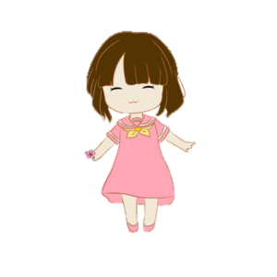


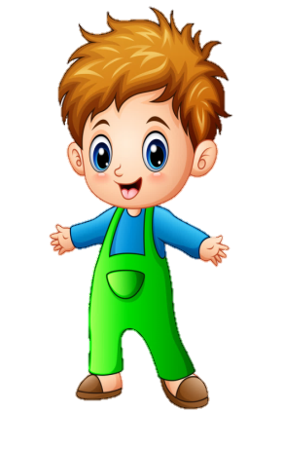


2. Aspiration refers to a puff of air when a sound is produced.
Kite
Guage
Tumbler
(kait)
(geij)
(Tuhm-blr)
Invitation
(in-vuh-tei-shn)
Channel
Genre
Tongue
(ch-nuhl)
(zhan-ra)
(tuhng)

Slide 14



3. Mouth Position- the shape of mouth when pronouncing a word.
Cheese
Oven
Love
(Cheez)
(Uh-vn)
(luhv)

Slide 15


4. Intonation- is about rising and falling intonation.
5. Linking- is about connecting or joining words to create a sentence.
Do you want me to call Hannah or Rica?
Where do you live?
I come to see you!
I hope you don’t mind.

Slide 16

6. Vowel Length- In linguistics, vowel length is the perceived length of a vowel sound: The corresponding physical measurement is duration.
Long Vowel example: Sixteen, Zoo, Food, Seat.
Short Vowel example: Six, Lad, Sun, Pick.

Slide 17


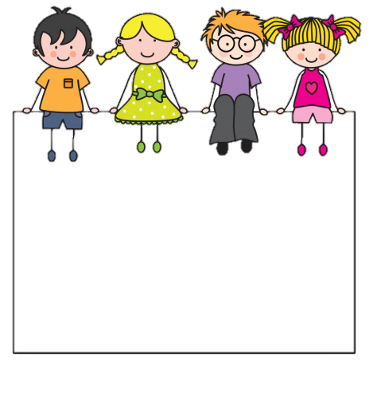


7. Syllables- This is a unit of pronunciation having one vowel sound, with or without surrounding consonants, forming the whole or a part of a word.
Beautiful- 3 syllables
Universe- 3 syllables
Antidisestablishmentarianism
Ready
University
Cat
Table
Human
Onomatopoeia

Slide 18
Assignment:
Select your favorite English song and record your voice while singing it. Pass it next week.

Slide 19
T
H
A
N
K
Y
O
U

